Slide 1
WRM200 Dual Polarization Weather Radars for Met. Service,
System Block Diagram
January 2020

Slide 2
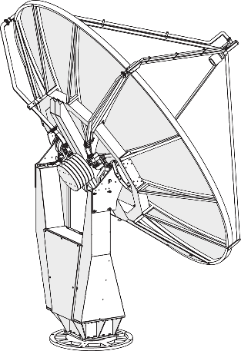
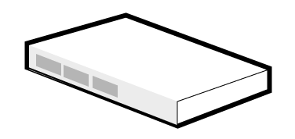
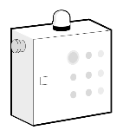
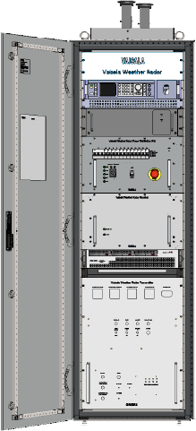
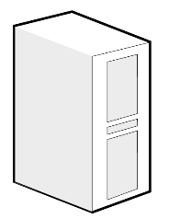
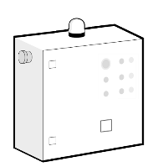

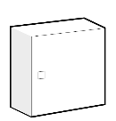
WRM200 Dual Polarization Doppler Weather Radar Site
Radar Station
Met. Service Radar Center
Radome
for Antenna and Pedestal
Servers and Workstations
Dual
Polarization
Antenna
WRA111
Pedestal
WRP221
Pedestal
Protection
Unit (PPU)
Radar Room
Waveguides
Antenna filters,
harmonic & bandpass
Uninterrupted
Power
Supply (UPS)
8 kVA
Main
Distribution
Unit (MDU)
TCP/IC
AC Power Input
230/400 VAC, 50Hz
3-phases, 5-wires
RAW Polar
Data Out
(TCP/IP)
Ave. 2100 W
≥ 2 Mbps
Battery
Backup
Unit (BBU)
WRM200 Dual Pol. Radar Cabinet with
RVP902 Server and
IRIS/Radar sw

Slide 3



Central Site Configuration
Met. Service in Podgorica
IRIS Analysis and
IRIS Focus Web servers
for product generation and display
Other optional data sources
(e.g. Lightning data, rain
gauge data)
HP
L2245w
IRIS Focus workstations
5 User Seats
(licenses)
New Vaisala
C-band
Weather
Radar
Native IRIS data or ODIM HDF5
HP
L2245w
Network data communication (TCP/IP)
Network data communication (https)
Ethernet
GB switch
Vrsuta
HP
L2245w
Internet
Optional remote IRIS users.
Accessing IRIS Focus software remotely

Slide 4
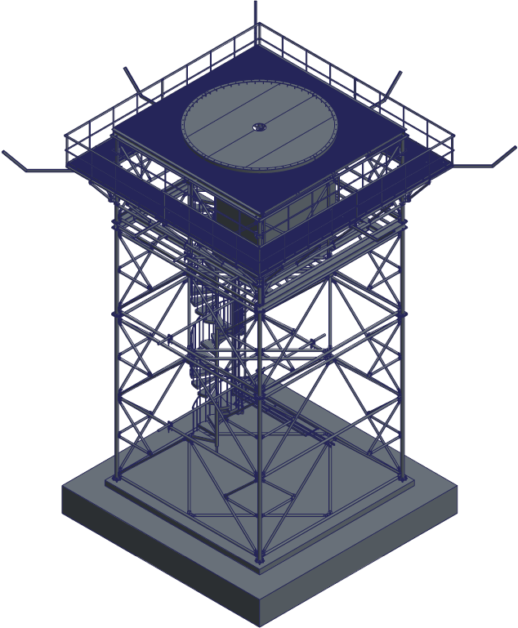
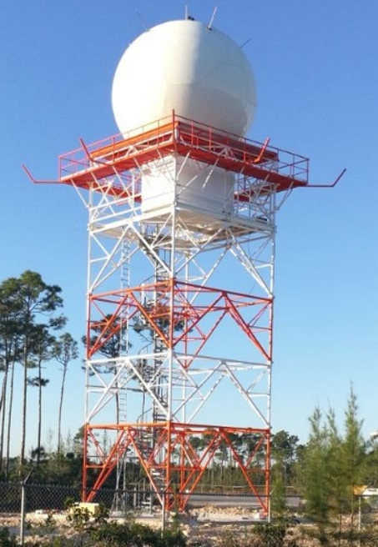
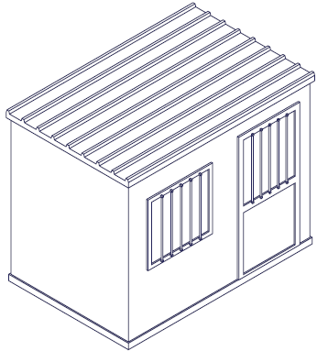
Weather Radar Tower and Equipment Shelter
Tower, 15 m
Shelter
Complete system

Slide 5
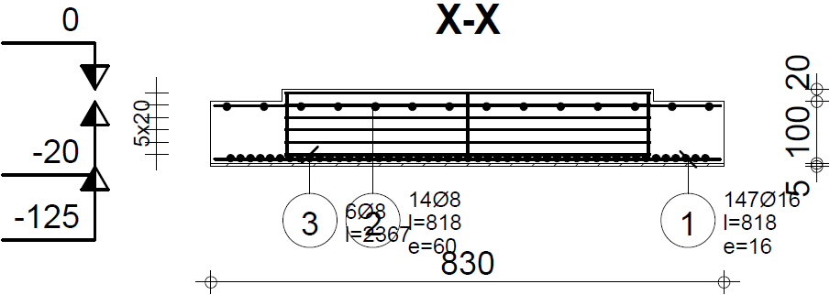
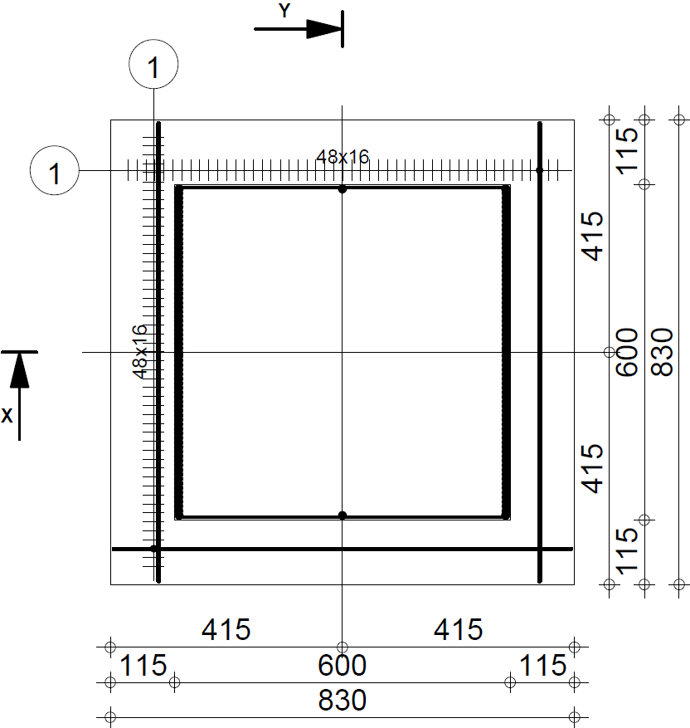
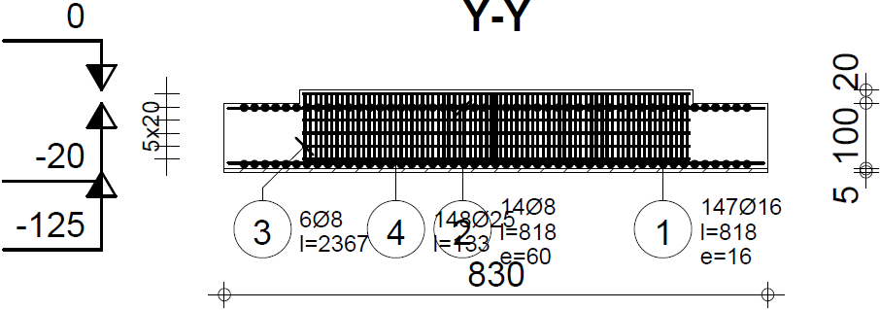
Foundation design for 15 m tower, for wind up to 60 m/s
Size 8.3 m x 8.3 m x 1.2 m
Tower Foundation – main features:
size 8.3 x 8.3 x 01.2 m³, volume 83 m³, weight 150 tn
reinforced concrete C30/37 (see the table below)
Formwork totally 30 m²
Pos | Reinforcement (A500HW) | Shape | Weight
1 | 147 pcs, Φ16 mm, tot. 1203 m | 818 cm | 1900 kg
2 | 14 pcs, Φ8 mm, tot. 115 m | 818 cm | 70 kg
3 | 6 pcs, Φ8 mm, tot. 95 m | 591 cm x 591 cm | 60 kg
4 | 148 pcs, Φ25 mm, tot. 205 m | 32 cm + 106 cm | 800 kg

Slide 6
Budgetary Pricing
Budgetary Pricing for one WRM200 and Central System with Services in k€ without tax
WRM200 Radar System with 1 year site warranty 765
Freight 10
Radome with accessories 80
IRIS Radar software 50
Radar System Factory Acceptance Tests, 3 days 5
Installation supervision by Vaisala, totally 20 days 30
Radar Site Acceptance Tests, 3 days 3
IRIS Focus & Analysis software, 5 seats 50
Central Site server(s) 6
Workstations with browsers, 5 pcs 5
Central Site installation, 4 days 6
Training at factory, Finland, 10 days 15
Training at site, 5 days 7.5
Training for Central System, 5 days 7.5
Five (5) years spare part set 50
Set of Test Equipment and Tools 40
TOTAL in EUR: 1100 k€
Optional extended warranty, price per year, incl.: 28
Preventive and repair maintenance at site
Express spare part delivery
Spare parts
Priority technical support
Local Site Works
Rent of cranes and lifting equipment 5
Installation / construction man force locally 20
Electricity and grounding installations at the site 10
Steel tower, 15 m high 100
Excavation works + materials 20
Tower concrete foundation, 8.3m x 8.3m x 1.2m, totally 83 m3 25
Radar equipment shelter 10
Air conditioning for radar shelter and radome 10
Back up diesel generator with shelter and installation 30
Site fencing and security 10
TOTAL in EUR: 240 k€

