Slide 1
Beam blockage analysis for Montenegro weather radar site
Jan 2020

Slide 2
Beam blockage analysis for Montenegro weather radar site
This document presents a beam blockage analysis for a potential weather radar site in Montenegro. The beam blockage analysis is based on a physical model that simulates the propagation of radar beam in the atmosphere. The model estimates the beam altitude with respect to Earth’s surface, and it takes in to account Earth curvature, digital terrain elevation model, and physical properties of propagating electromagnetic waves under standard atmospheric conditions. In the case the beam encounters an obstacle (e.g. a hill or mountain), the model estimates the amount of blockage.
It is important to note that the analysis considers only blockage due to terrain. For example, it does not take into account nearby high-rising buildings, radio masts, trees, or other possible obstacles

Slide 3
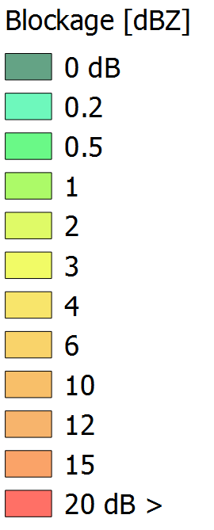
Beam blockage analysis for Montenegro weather radar sites
The analysis was calculated using radar elevation angles of 0.5, 0.7, 1.0 and 1.5 degrees. With higher elevations the altitude of the beam increases quickly with distance, decreasing the overall quality and utility of radar observations.
Tower height of 15 m was used in the analysis
The amount of beam blockage in the images is indicated with color coding
Shows the amount of power loss of radar signal in dB
Please see the attached legend
Interpretation of the colors as follows:
Red color: Complete loss of the radar signal (complete blockage),
Yellow: Partial loss (radar can still observe, but with very limited capacity)
Green moderate loss

Slide 4
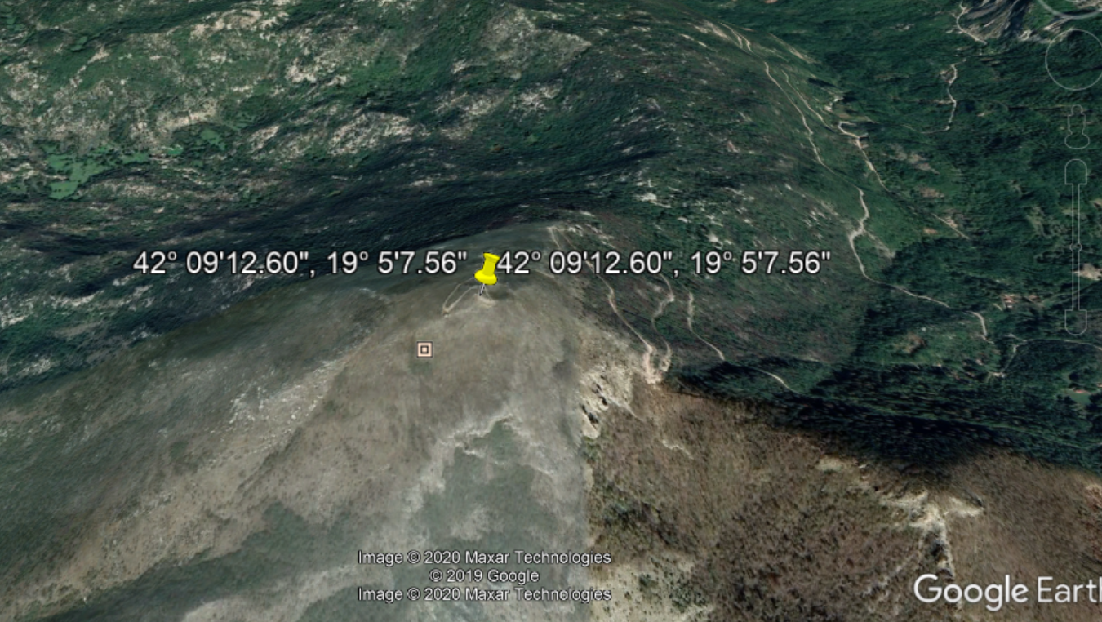
Evaluated site
Lat 42° 09'12.60"N , Lon 19° 5'7.56"E, Alt 1166 m

Slide 5
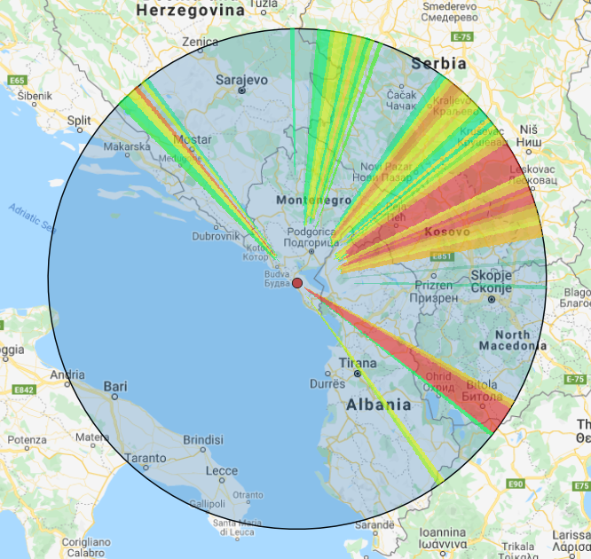
Site: Lat 42° 09'12.60"N , Lon 19° 5'7.56"E, Alt 1166 m
Beam blockage analysis with antenna elevation of 0.5 degrees up to 250 km in range
Sectors of beam blockage in several directions

Slide 6
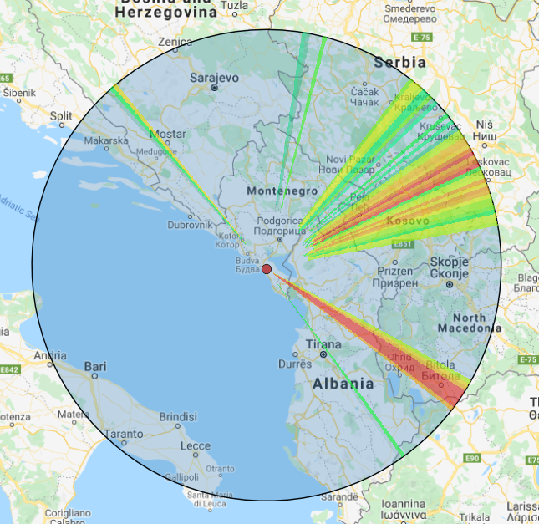
Site: Lat 42° 09'12.60"N , Lon 19° 5'7.56"E, Alt 1166 m
Beam blockage analysis with antenna elevation of 0.7 degrees up to 250 km in range
Sectors of beam blockage in several directions

Slide 7
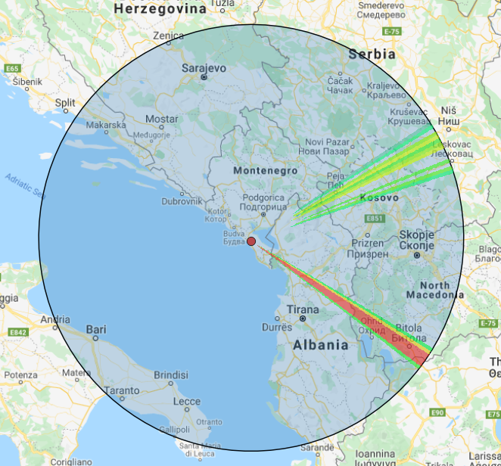
Site: Lat 42° 09'12.60"N , Lon 19° 5'7.56"E, Alt 1166 m
Beam blockage analysis with antenna elevation of 1.0 degrees up to 250 km in range
The amount of blockage decreases significantly.

Slide 8
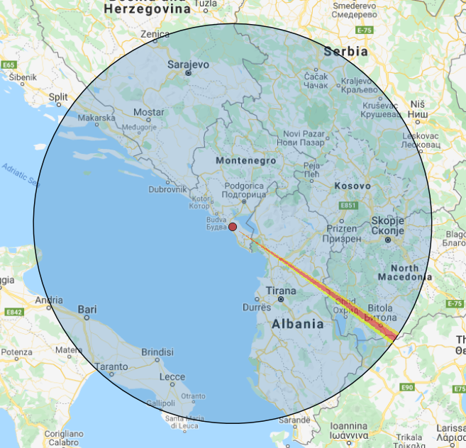
Site: Lat 42° 09'12.60"N , Lon 19° 5'7.56"E, Alt 1166 m
Beam blockage analysis with antenna elevation of 1.5 degrees up to 250 km in range
The amount of blockage decreases nearly completely. However, sector of intense blockage in SE direction persists.
Note that 1.5 degree elevation angle is quite high for operational weather radar activities.

